Slide 1


Dso 428
Session 3

Slide 2
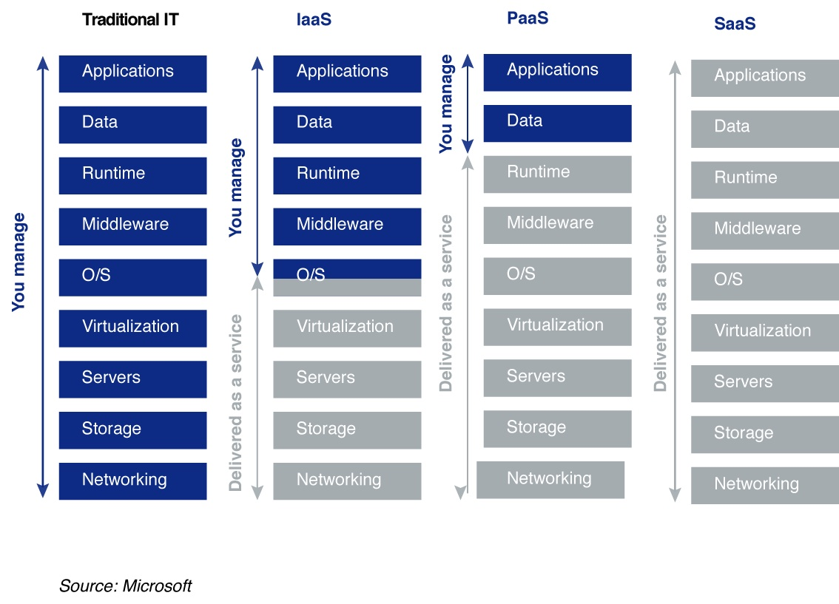

Slide 3

Network Packet
A network packet is a formatted unit of data carried by a packet-switched network.
Source: Wikipedia

Slide 4
What did we cover last week?
CRISP-DM Framework
Data basics
How data flows through the enterprise, data sources
Data pyramid
Enterprise systems (ERP, CRM, HRIS)
Database fundamentals
File vs. DB, DBMS, Data quality, Database schema
ANSI-SPARC 3-Level Architecture
External, Conceptual, Internal Levels
Conceptual data modeling

Slide 5
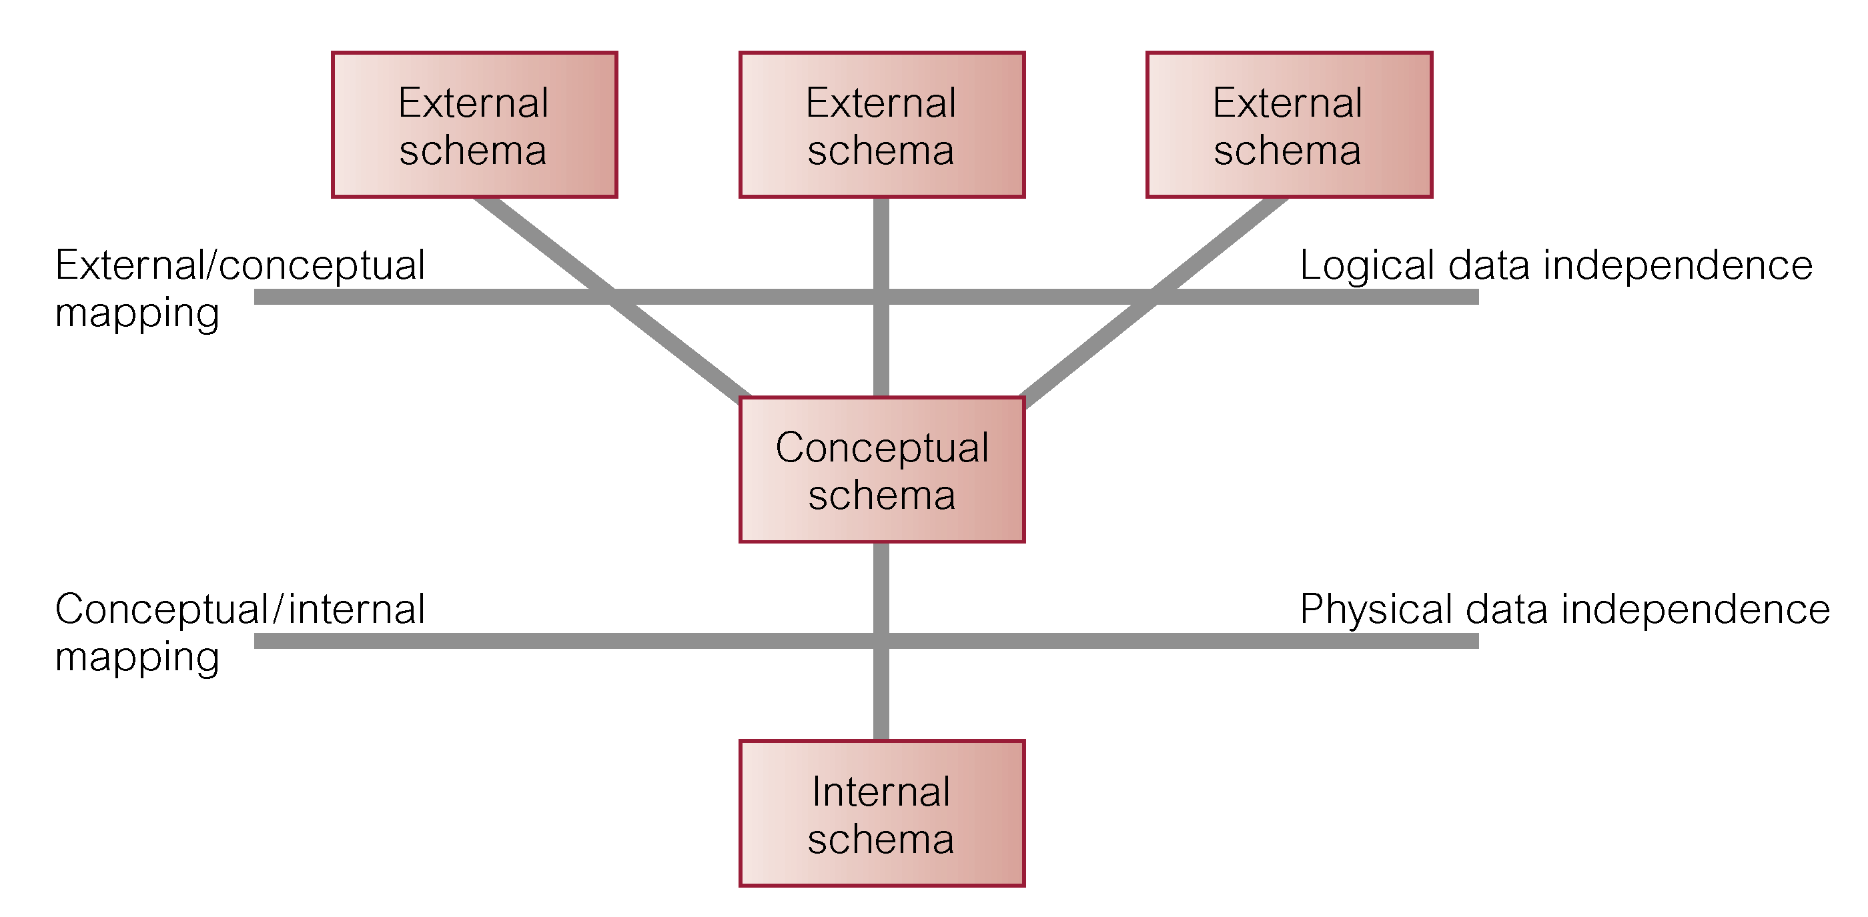
Logical Data Independence
Supported by
Change the middle level
without affecting the
upper level

Slide 6
Conceptual modeling
Conceptual schema
The core of a database system supporting all user views.
Should be complete and accurate representation of an organization's data requirements.
Conceptual modeling is process of developing a model of information use that is independent of implementation details. Focus: E-R model
Result is a conceptual data model.
Notes:
That is, conceptual model is DBMS-independent

Slide 7
relational Keys
Key: Combination of one or more columns that is used to identify rows in a relation
Candidate Key - A specific type of field in a relational database that can identify each unique record independently of any other data.
Super Key: An attribute or a set of attributes in a relation that uniquely identifies a tuple within the relation.
Composite Key - Key that consists of 2 or more columns

Slide 8
Super key
A set of attributes that can uniquely identify a tuple
Name | UID | FB_ID | SSN | GPA | Degree | Grad_Yr
John Smith | 110718 | 882459 | 12345 | 3.7894 | BUAD | 2024
UID?
Name
SSN?
FB_ID?
UID+SSN?
Name+GPA+Degree+Grad_Yr?

Slide 9
Super key
Can you uniquely identify a student's record by putting his/her (UID,fname,lname) into search?
Yes, the system would only return one unique row! Thus, (UID,fname,lname) TOGETHER is a superkey of this table.
They are consistent with the definition of superkey --- "a set of attributes that can uniquely identify a tuple" For the same reason, (UID,fname) or (SSN, GPA) or (UID,Degree) or (UID,GPA), etc. etc. are all superkeys of the table.

Slide 10
Super Key vs. Candidate Key
Super key is composed of a set of attributes that identify a unique record. Can be multiple columns.
Candidate key also identifies a unique record, but is composed of one individual field or column

Slide 11
Candidate key
A Superkey that no proper subset is a Superkey within the relation
Uniqueness: the values uniquely identify that tuple
Irreducibility: no proper subset is a super key for the relation
A Composite Key is when a key consists of more than one attribute – composite key.
A relation may have multiple candidate keys.

Slide 12
Primary Key
A candidate key selected as the primary means of identifying rows in a relation
There is only one per relation
May be a composite key
Ideally is short, numeric, and never changes

Slide 13
Alternate key
Candidate key not selected a primary key

Slide 14
Foreign Key
Primary key of one relation that is placed in another relation to form a link between relations
A foreign key can be a single column or a composite key
The term refers to the fact that key values are foreign to the relation in which they appear as foreign key values

Slide 15
Primary vs. Foreign Keys
Primary key is a column or a set of columns that uniquely identify a row in a table. A primary key should be short, stable and simple.
A table can only have one primary key
Foreign key is a field (or collection of fields) in a table whose value is required to match the value of the primary key for a second table.
A table can have multiple foreign keys

Slide 16
Three step procedure to identify A Super/Candidate/Primary Key/Alternative Key
(Given) A Set of Attribute(s)
UID | FB_ID | SSN
110718 | 882459 | 12345
Yes
P1: Can you use the set of attribute(s) to uniquely identify a row in the table?
No
Not key of the table
Pick another set of attribute(s)
Super Key
P2: Can you REDUCE the super key but still uniquely identify a row in the table?
Yes
No
Candidate Key
Super Key
(but not CK)
P2: Is it chosen as a Primary Key? (by us or already chosen)
No
Yes
Primary Key
Alternate Key

Slide 17
Relational Keys
Primary Key (PK)
The candidate key selected to identify tuples uniquely within a relation.
Alternate Keys
Candidate keys that are not selected to be primary key.
Foreign Key (FK)
An attribute, or set of attributes, within one relation.
Matches the candidate key of some (possibly same) relation.
i.e. foreign key references primary key.
Name | UID | FB_ID | SSN | GPA | Degree | Grad_Yr
John Smith | 110718 | 882459 | 12345 | 3.7894 | IS | 2014
Construct the relationship between tables through FK/PK!!
Notes:
After explanation, Identify together primary keys and foreign keys of Figure 4.3 and Figure 6.6 (handout).

Slide 18
Relational Databases – Integrity Rules
Relational tables follow certain integrity rules to ensure that the data they contain stays accurate and is always accessible. First, the rows in a relational table should all be distinct. If there are duplicate rows, there can be problems resolving which of two possible selections is the correct one.
Primary Key
Unique column or group of columns
Cannot be null; if it were, the primary key containing it would no longer be a complete identifier. This rule is referred to as entity integrity.
Source: https://docs.oracle.com/javase/tutorial/jdbc/overview/database.html

Slide 19
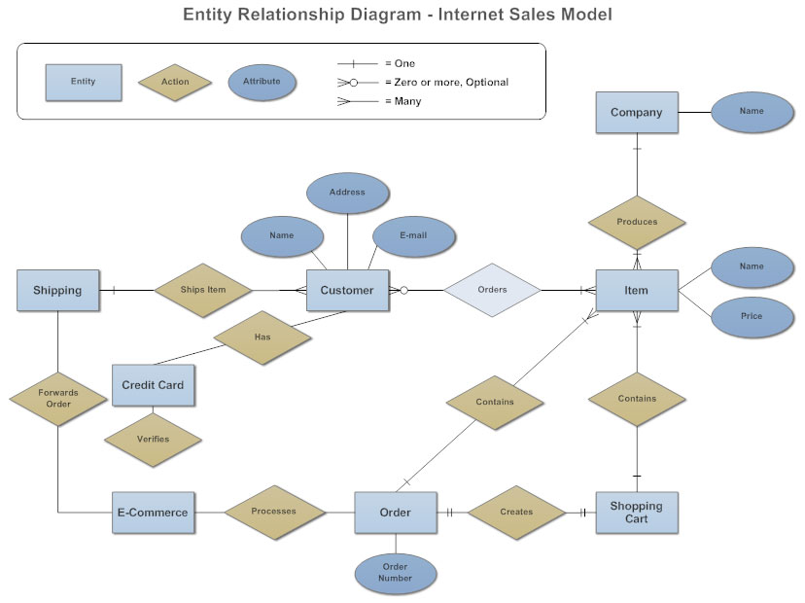
Entity-Relationship Diagram (ERD)

Slide 20
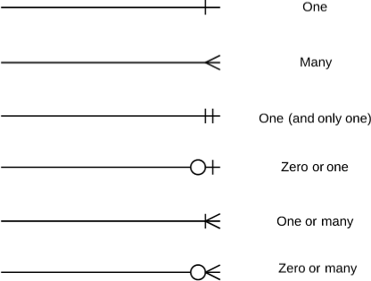
ER Symbols
Source: https://www.lucidchart.com/pages/ER-diagram-symbols-and-meaning

Slide 21
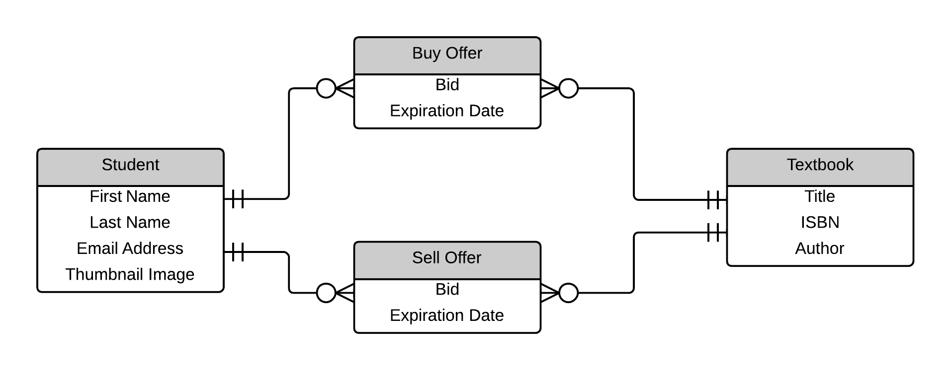
ER Diagram
Source: https://www.lucidchart.com/pages/ER-diagram-symbols-and-meaning

